Slide 1
Emotion Based
Music Recommendation System based on Sportyfy API

Slide 2
ABSTRACT
In this paper author is describing concept to recommend music to user by detecting moods of user. Existing technique were using collaboration technique which will use previous user data to recommend music to user, if there is no input from previous user then this technique will not useful. This existing technique requires lots of manual work to arrange different music to different categories such as happy, sad or angry etc. In this paper author is describing concept to recommend music to user by detecting moods of user. Existing technique were using collaboration technique which will use previous user data to recommend music to user, if there is no input from previous user then this technique will not useful. This existing technique requires lots of manual work to arrange different music to different categories such as happy, sad or angry etc.

Slide 3
To overcome from above issue author is using ‘Wearable Physiological Sensors’and this sensors will send signals to application regarding user current status and then this application using SVM (support vector machine) and deep learning neural network algorithms will classify/predict the mood by extracting features from signal. SVM algorithm will be trained with all mood based signals data and whenever a new signal received then SVM/deep learning neural networks will apply new signal on train data to classify user moods. Based on detected user mood song list will be display/recommend to the user.
As student we cannot afford to buy sensors for this project so we are using images with faces to detect user mood and to recommend music. As faces are the best option to predict mood of the users. We tried a lot to search sensors data to classify mood but on internet no such datasets are available.

Slide 4
NO OF MODULES
Dataset Collection
Deep learning neural network algorithms
Face Detection
Mood Detection
Music Recommendation

Slide 5
MODULES DESCRIPTION
DATASET COLLECTION
The emotion recognition model is trained on FER 2013 dataset. It can detect 7 emotions. The project works by getting live video feed from web cam, pass it through the model to get a prediction of emotion. Then according to the emotion predicted, the app will fetch playlist of songs from Spotify through spotipy wrapper and recommend the songs by displaying them on the screen.

Slide 6
DEEP LEARNING NEURAL NETWORK ALGORITHMS
To overcome from above issue author is using ‘Wearable Physiological Sensors’and this sensors will send signals to application regarding user current status and then this application using SVM (support vector machine) and deep learning neural network algorithms will classify/predict the mood by extracting features from signal. SVM algorithm will be trained with all mood based signals data and whenever a new signal received then SVM/deep learning neural networks will apply new signal on train data to classify user moods. Based on detected user mood song list will be display/recommend to the user.

Slide 7
FACE DETECTION
As faces are the best option to predict mood of the users. We tried a lot to search sensors data to classify mood but on internet no such datasets are available.
MOOD DETECTION
In this application I am uploading image and then using python OPENCV i am pre-processing image to extract features and then this features is applied on SVM/Deep Learning Neural Network Training Model to predict moods of user and based on user mood all songs will be detected and shown in drop down box and user can select any song and play.

Slide 8
MUSIC RECOMMENDATION
All sample images are in images folder and all songs are in songs folder and u too can include new songs to that folder and given name as happy1.mp3, happy2, happy3 or sad1, sad2 etc. Like this for all categories you can add songs. Currently i am using same song for all moods.

Slide 9
METHODOLOGY
SOFTWARE REQUIREMENT
Operating System : WINDOWS 7
Service Pack : WINDOWS 7
SOFTWARE USED
Front - End : Python Open CV,Flask
Back - End : Dataset FER 2013
Domain Name : Machine Learning

Slide 10
EXISTING SYSTEM
Recommend music to user by detecting moods of user. Existing technique were using collaboration technique which will use previous user data to recommend music to user, if there is no input from previous user then this technique will not useful. This existing technique requires lots of manual work to arrange different music to different categories such as happy, sad or angry etc.

Slide 11
PROPOSED SYSTEM
Real time expression detection and song recommendations.
Playlists fetched from Spotify using API.
Neumorphism UI for website.

Slide 12
CONCLUSION
The primary goal of an emotion-based music player is to provide user-preferred music with emotion identification by automatically playing songs based on the user's feelings. In the current system, the user must manually choose the tunes because songs generated at random may not suit the user's mood

Slide 13
EMOTION DATABASE DESIGN
We Used 7 dataset in excel related to music album , artist data we used 2013 kagale dataset 7 emotion detection
Angry
Fear
Happy
Neutral
Surprise
Sad
Happy

Slide 14
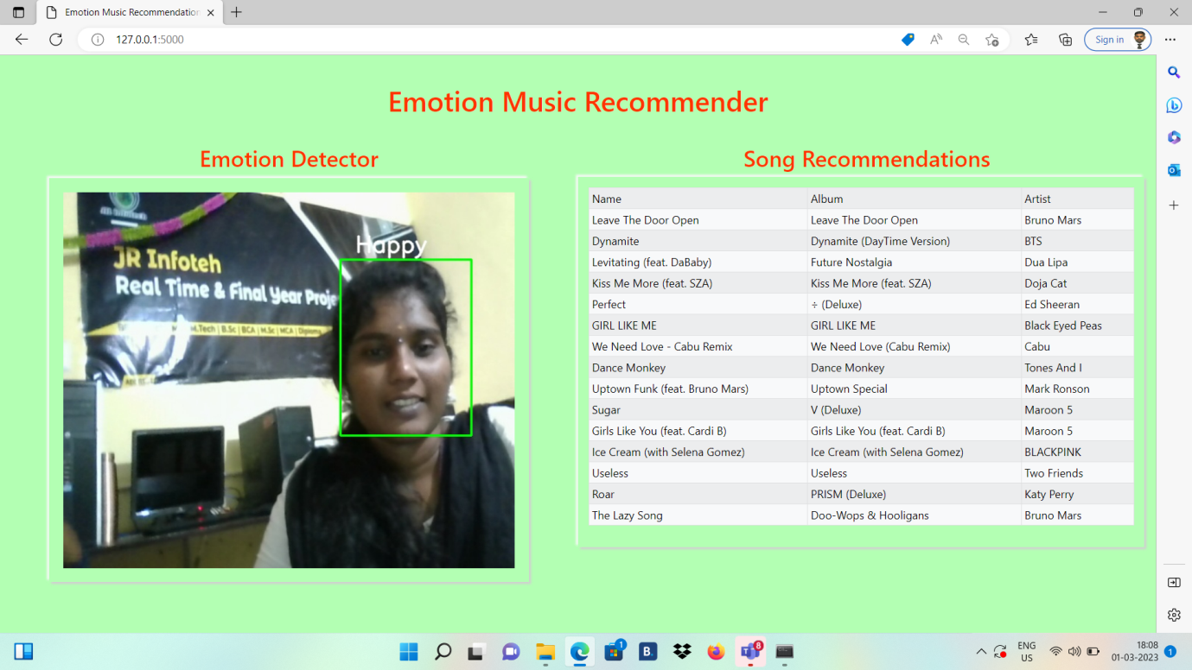

Slide 15
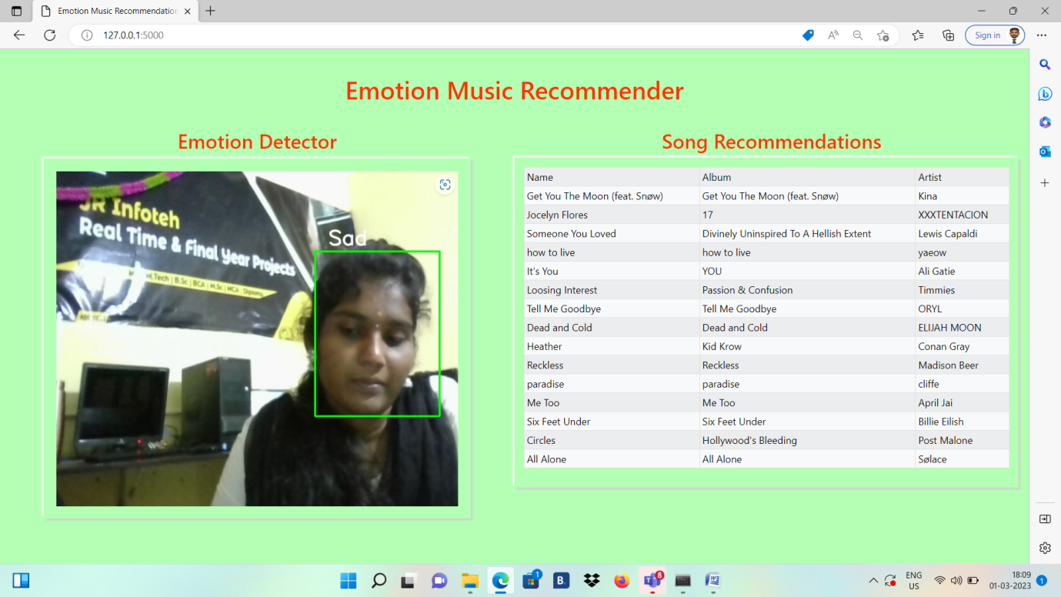

Slide 16
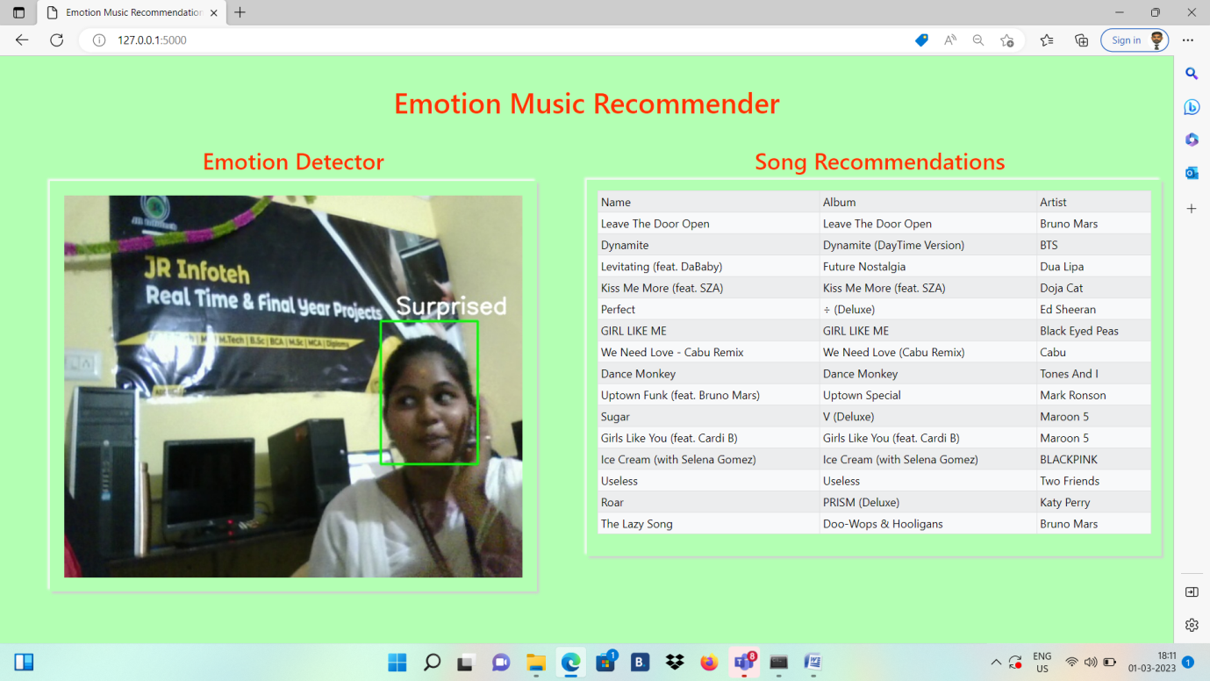

Slide 17
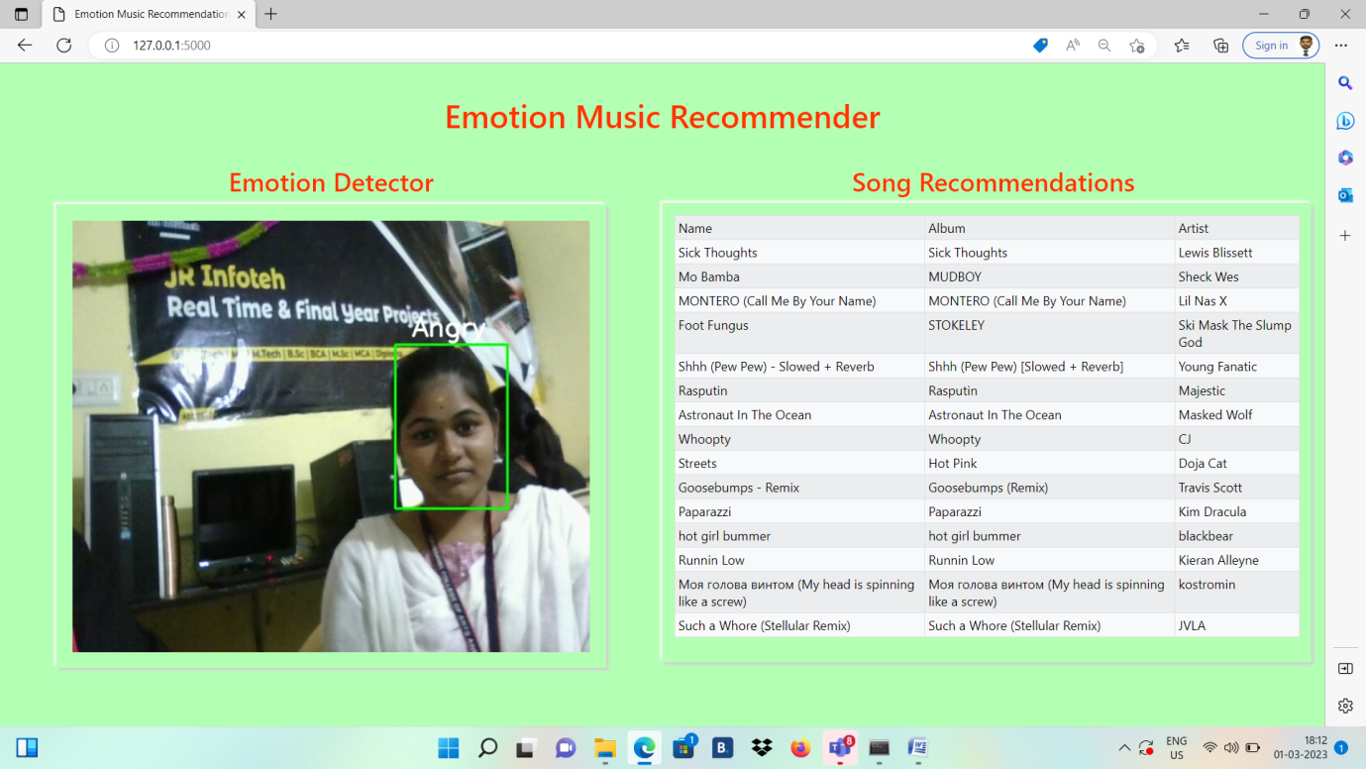

Slide 18
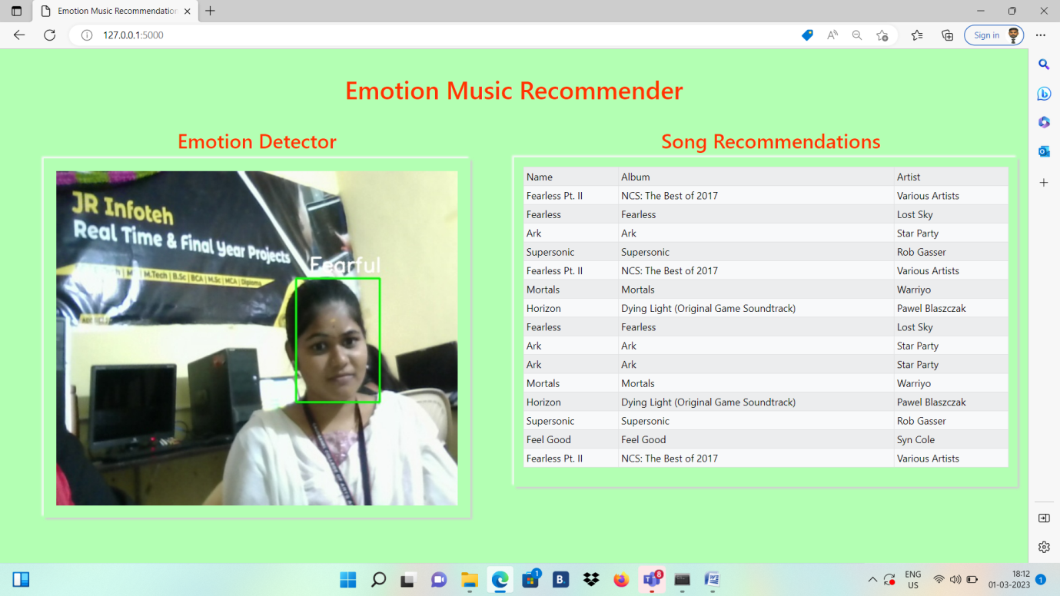

Slide 19
SOURCE CODE
APP.py
from flask import Flask, render_template, Response, jsonify
import gunicorn
from camera import *
app = Flask(__name__)
headings = ("Name","Album","Artist")
df1 = music_rec()
df1 = df1.head(15)
@app.route('/')
def index():
print(df1.to_json(orient='records'))
return render_template('index.html', headings=headings, data=df1)
def gen(camera):
while True:
global df1
frame, df1 = camera.get_frame()
yield (b'--frame\r\n‘
b'Content-Type: image/jpeg\r\n\r\n' + frame + b'\r\n\r\n')
@app.route('/video_feed')
def video_feed():

Slide 20
return Response(gen(VideoCamera()),
mimetype='multipart/x-mixed-replace; boundary=frame')
@app.route('/t')
def gen_table():
return df1.to_json(orient='records')
if __name__ == '__main__':
app.debug = True
app.run()
spotyfy.py
import spotipy
import spotipy.oauth2 as oauth2
from spotipy.oauth2 import SpotifyOAuth
from spotipy.oauth2 import SpotifyClientCredentials
import pandas as pd
import time
auth_manager = SpotifyClientCredentials('','')
sp = spotipy.Spotify(auth_manager=auth_manager)
def getTrackIDs(user, playlist_id):

Slide 21
track_ids = []
playlist = sp.user_playlist(user, playlist_id)
for item in playlist['tracks']['items']:
track = item['track']
track_ids.append(track['id'])
return track_ids
def getTrackFeatures(id):
track_info = sp.track(id)
name = track_info['name']
album = track_info['album']['name']
artist = track_info['album']['artists'][0]['name']
# release_date = track_info['album']['release_date']
# length = track_info['duration_ms']
# popularity = track_info['popularity']
track_data = [name, album, artist] #, release_date, length, popularity
return track_data
# Code for creating dataframe of feteched playlist
emotion_dict = {0:"Angry",1:"Disgusted",2:"Fearful",3:"Happy",4:"Neutral",5:"Sad",6:"Surprised"}

Slide 22
music_dist={0:"0l9dAmBrUJLylii66JOsHB?si=e1d97b8404e34343",1:"1n6cpWo9ant4WguEo91KZh?si=617ea1c66ab6446b ",2:"4cllEPvFdoX6NIVWPKai9I?si=dfa422af2e8448ef",3:"0deORnapZgrxFY4nsKr9JA?si=7a5aba992ea14c93",4:"4kvSlabrnfRCQWfN0MgtgA?si=b36add73b4a74b3a",5:"1n6cpWo9ant4WguEo91KZh?si=617ea1c66ab6446b",6:"37i9dQZEVXbMDoHDwVN2tF?si=c09391805b6c4651"}
'''
Code can def be modularised into a function but i tried to write it when i was extremely sleepy so thought screw it and repeated code block
Uncomment for fetching updated playlists
'''
# track_ids = getTrackIDs('spotify',music_dist[0])
# track_list = []
# for i in range(len(track_ids)):
# time.sleep(.3)
# track_data = getTrackFeatures(track_ids[i])
# track_list.append(track_data)
# df = pd.DataFrame(track_list, columns = ['Name','Album','Artist']) # ,'Release_date','Length','Popularity'
# df.to_csv('songs/angry.csv')
# print("CSV Generated")

Slide 23
# track_ids = getTrackIDs('spotify',music_dist[1])
# track_list = []
# for i in range(len(track_ids)):
# time.sleep(.3)
# track_data = getTrackFeatures(track_ids[i])
# track_list.append(track_data)
# df = pd.DataFrame(track_list, columns = ['Name','Album','Artist']) # ,'Release_date','Length','Popularity'
# df.to_csv('songs/disgusted.csv')
# print("CSV Generated")
# track_ids = getTrackIDs('spotify',music_dist[2])
# track_list = []
# for i in range(len(track_ids)):
# time.sleep(.3)
# track_data = getTrackFeatures(track_ids[i])
# track_list.append(track_data)
# df = pd.DataFrame(track_list, columns = ['Name','Album','Artist']) # ,'Release_date','Length','Popularity'
# df.to_csv('songs/fearful.csv')
# print("CSV Generated")

Slide 24
# track_ids = getTrackIDs('spotify',music_dist[3])
# track_list = []
# for i in range(len(track_ids)):
# time.sleep(.3)
# track_data = getTrackFeatures(track_ids[i])
# track_list.append(track_data)
# df = pd.DataFrame(track_list, columns = ['Name','Album','Artist']) # ,'Release_date','Length','Popularity'
# df.to_csv('songs/happy.csv')
# print("CSV Generated")
# track_ids = getTrackIDs('spotify',music_dist[4])
# track_list = []
# for i in range(len(track_ids)):
# time.sleep(.3)
# track_data = getTrackFeatures(track_ids[i])
# track_list.append(track_data)
# df = pd.DataFrame(track_list, columns = ['Name','Album','Artist']) # ,'Release_date','Length','Popularity'
# df.to_csv('songs/neutral.csv')
# print("CSV Generated")

Slide 25
# track_ids = getTrackIDs('spotify',music_dist[5])
# track_list = []
# for i in range(len(track_ids)):
# time.sleep(.3)
# track_data = getTrackFeatures(track_ids[i])
# track_list.append(track_data)
# df = pd.DataFrame(track_list, columns = ['Name','Album','Artist']) # ,'Release_date','Length','Popularity'
# df.to_csv('songs/sad.csv')
# print("CSV Generated")
# track_ids = getTrackIDs('spotify',music_dist[6])
# track_list = []
# for i in range(len(track_ids)):
# time.sleep(.3)
# track_data = getTrackFeatures(track_ids[i])
# track_list.append(track_data)
# df = pd.DataFrame(track_list, columns = ['Name','Album','Artist']) # ,'Release_date','Length','Popularity'
# df.to_csv('songs/surprised.csv')
# print("CSV Generated")

Slide 26
Train.py
from keras.models import Sequential
from keras.layers import Dense, Dropout, Flatten
from keras.layers import Conv2D
from keras.layers import MaxPooling2D
from keras.optimizers import Adam
from keras.preprocessing.image import ImageDataGenerator
train_dir = 'data/train'
val_dir = 'data/test'
train_datagen = ImageDataGenerator(rescale=1./255)
val_datagen = ImageDataGenerator(rescale=1./255)
train_generator = train_datagen.flow_from_directory(
train_dir,
target_size = (48,48),
batch_size = 64,
color_mode = "grayscale",
class_mode = 'categorical'
)

Slide 27
val_generator = val_datagen.flow_from_directory(
val_dir,
target_size = (48,48),
batch_size = 64,
color_mode = "grayscale",
class_mode = 'categorical'
)
emotion_model = Sequential()
emotion_model.add(Conv2D(32, kernel_size=(3,3), activation='relu', input_shape = (48,48,1)))
emotion_model.add(Conv2D(64, kernel_size=(3,3), activation='relu'))
emotion_model.add(MaxPooling2D(pool_size=(2,2)))
emotion_model.add(Dropout(0.25))
emotion_model.add(Conv2D(128, kernel_size=(3,3), activation='relu'))
emotion_model.add(MaxPooling2D(pool_size=(2,2)))
emotion_model.add(Conv2D(128, kernel_size=(3,3), activation='relu'))
emotion_model.add(MaxPooling2D(pool_size=(2,2)))
emotion_model.add(Dropout(0.25))

Slide 28
emotion_model.add(Flatten())
emotion_model.add(Dense(1024, activation='relu'))
emotion_model.add(Dropout(0.5))
emotion_model.add(Dense(7, activation='softmax'))
emotion_model.compile(loss='categorical_crossentropy',optimizer=Adam(lr=0.0001, decay=1e-6),metrics=['accuracy'])
emotion_model_info = emotion_model.fit_generator(
train_generator,
steps_per_epoch = 28709 // 64,
epochs=20,
validation_data = val_generator,
validation_steps = 7178 // 64
)
emotion_model.save_weights('model.h5')

Slide 29
THANK YOU!!!!

